Slide 1
CE4E2 Project Presentation
“Compare and contrast existing domain/web – site security/ privacy measurement web sites”
By Hlib Fedchuk
Under the guidance of Stephen Farrell

Slide 2
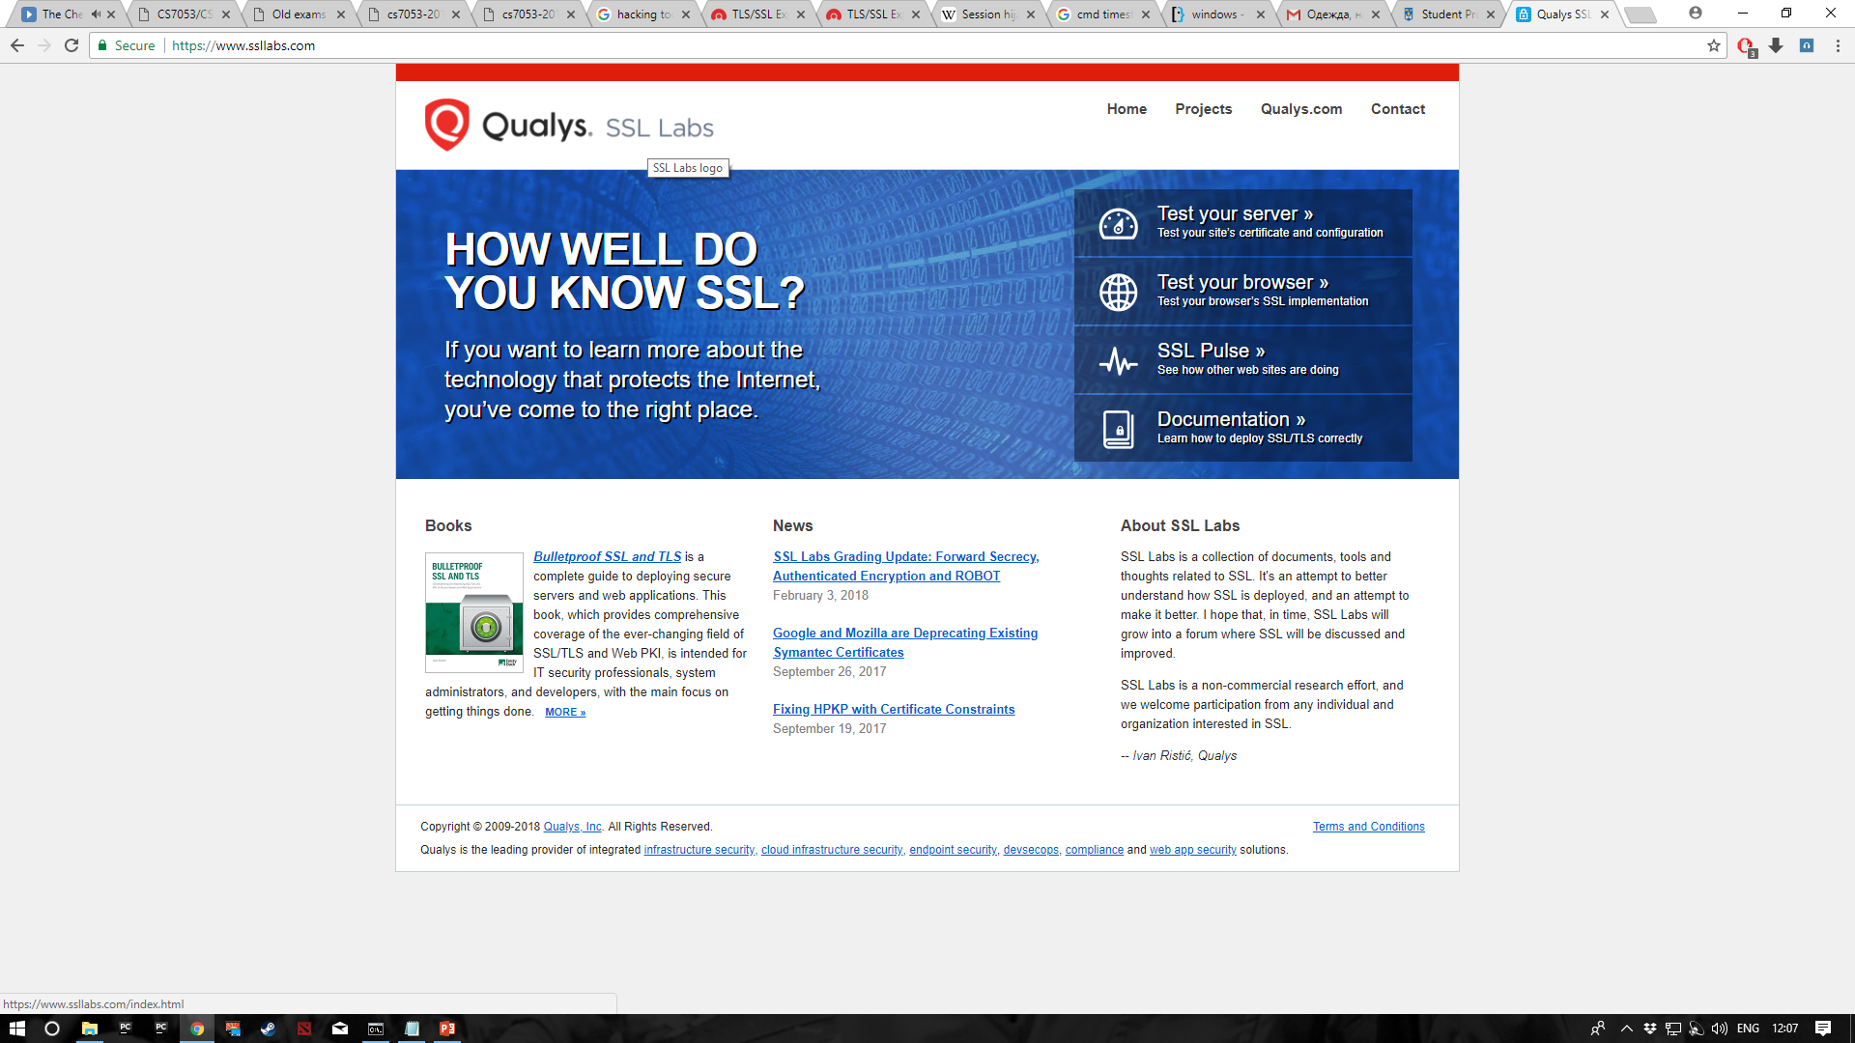
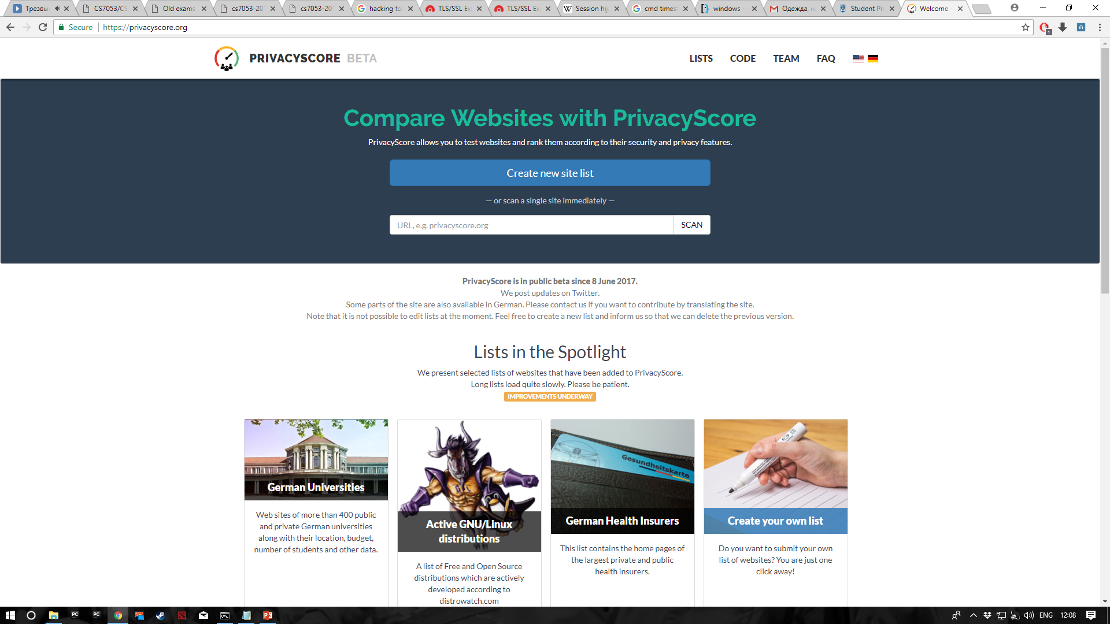
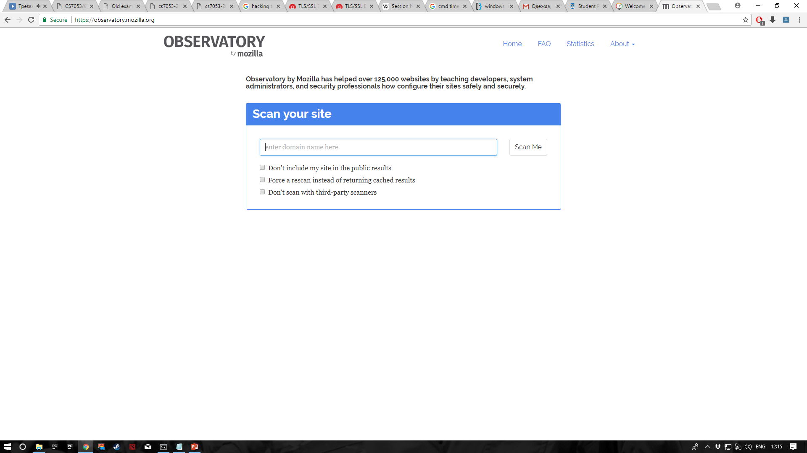
Introduction
There are a lot of different testers on the internet and the results vary depending on their “understanding”.
Therefore, the purpose of this project is compare and contrast those testers in order to find the most efficient ones.

Slide 3
Background
The main goal of this project was to find out which testers allow the use of command line interface in order to fetch the results and then be able to compare the testers depending on the generated results. Sone testers don’t allow the use of command line interface, thus for a worst case scenario screen scraping was used.
Go was used for some testers as they require this programing language to work with them.
I am a Windows guy, but for Mozilla Observatory, I had to use Ubuntu VM, as these guys don’t support Windows
This project consisted of 4 different Methodologies: Research, Differentiating the testers, Fetching the results and Evaluation.

Slide 4
Methodology – Research testers
The first task was to surf online in order to find all possible testers.
Each tester would then be added to the overall list.
List will be updated each time dependent on what information/results/documentation/api availability.
List will be broken down into different sections depending on the specificity of the tester.
A GitHub wiki was created in order to keep track on the progress of the list.

Slide 5
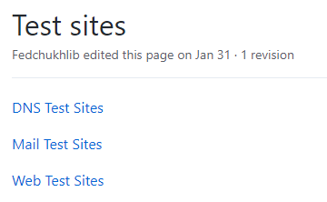
Methodology –Differentiating the testers
3 Types of testers in total.
DNS, TLS and overall Web testers.
Image on the right showing the GitHub wiki page where the testers are put to their corresponding list.
The following slides show the final list of test sites and the result availability in JSON.

Slide 6
Methodology –Differentiating the testers
Reasons for picking the specific tester:
Availability of exported results – only take the ones that can be worked with
Picking well known testers – evaluating the testers that are mostly used
Pick one that doesn’t export results/not giving enough in the results - ability to try screen scraping from HAR files, using some script to get rid of some extra bits of information that we are not interested in.

Slide 7
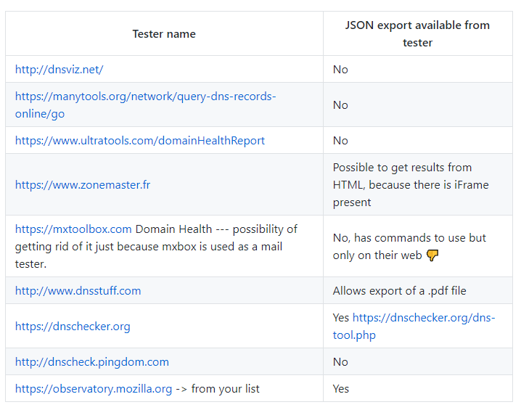
Methodology – DNS Testers

Slide 8
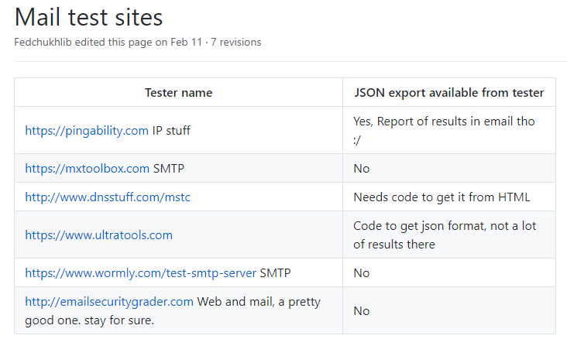
Methodology –TLS testers

Slide 9
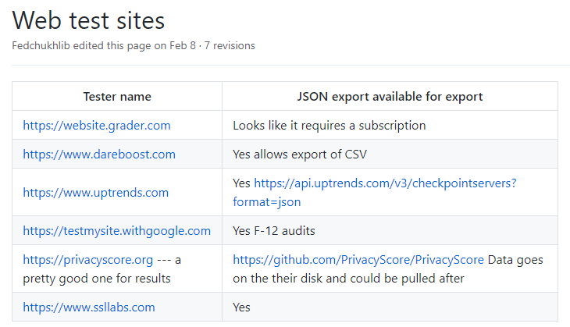
Methodology – Overall Web testers

Slide 10
Methodology – Fetching the results
When the testers were picked and installed (pulling from GitHub), there needs to be some automation in gathering the results.
Because I’m a Windows guy, the script for automation was done I a .bat file that can be run from either the command line or by clicking on it.
The bat file changes the directory to the required tester directory and creating a current timestamp directory where the results will be saved.
Timestamp format was used in order to check if the website has gone through some changes and the end mark given by the tester will change.
The results will be stored in JSON in order to compare then at a later stage of the project.

Slide 11
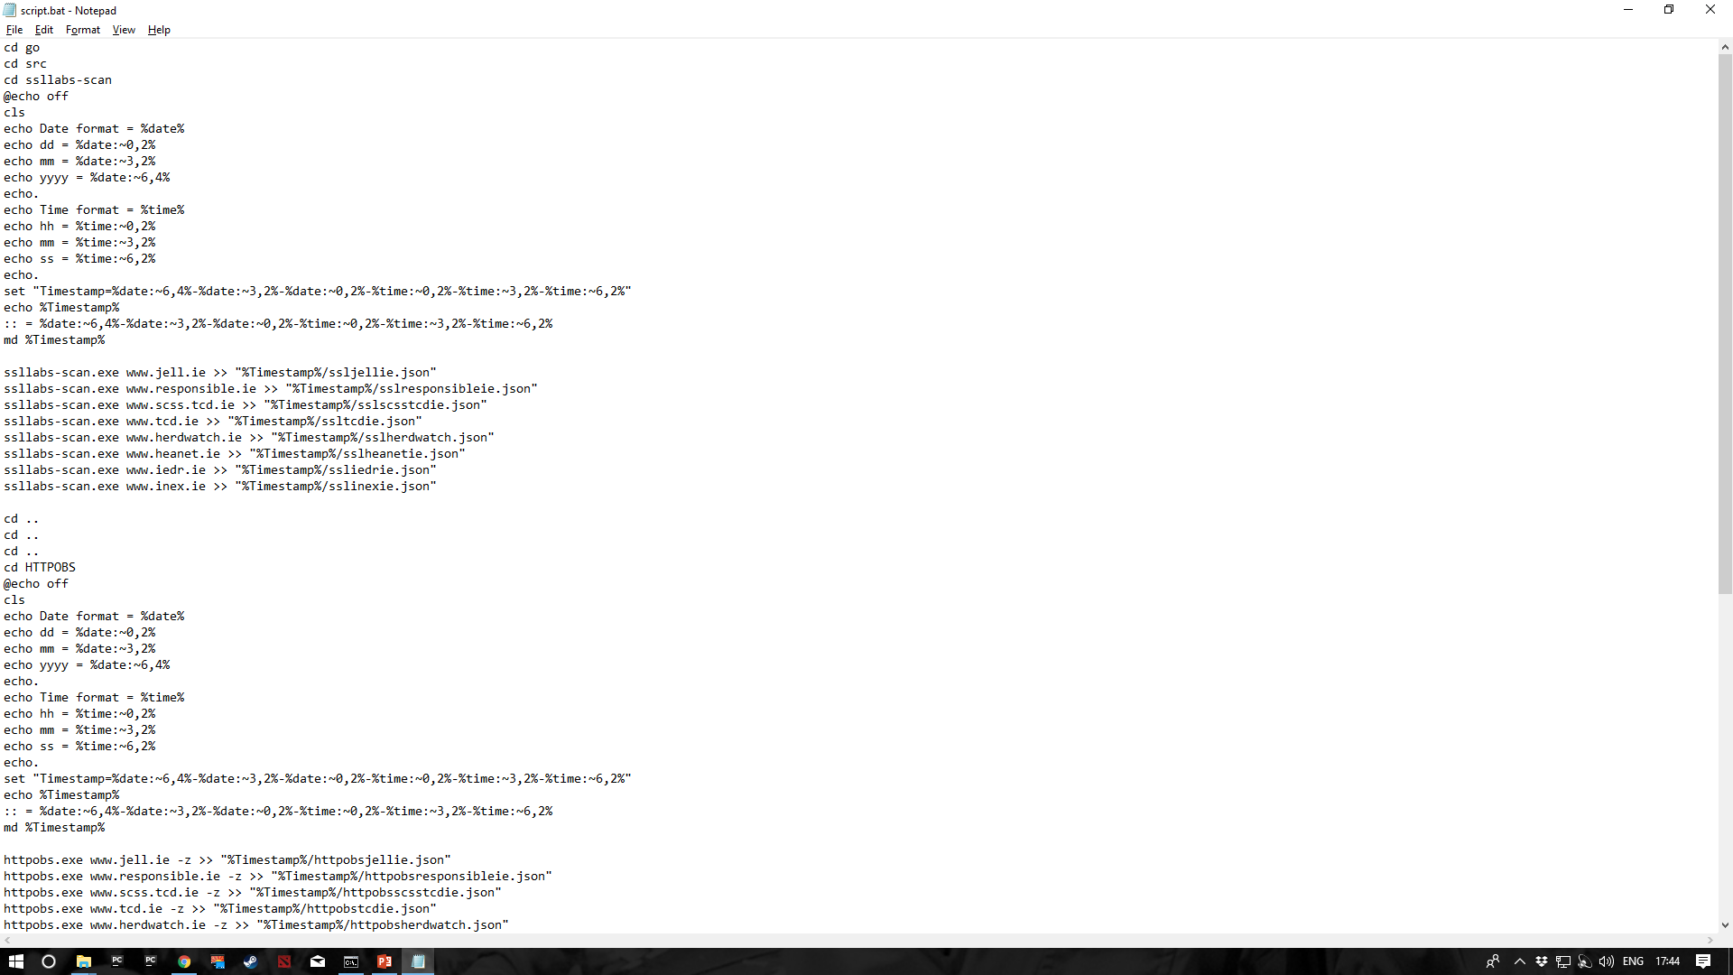
Methodology – Fetching the results
First things first, the required directory is chosen where the .exe file is in order to run the tests.
Timestamp is gathered and a directory with timestamp as a name is created, where the results will be stored. I.e. New run -> new directory -> new results (unique and no overwrite)
Ssllab-scan.exe “testSite” only outputs the result to the cmd window. “>>” saves it to a file

Slide 12
Methodology –Fetching the results
The following the rest of the .bat file. The only difference here is that the directory should go back to default, in my case “C:/Users”

Slide 13
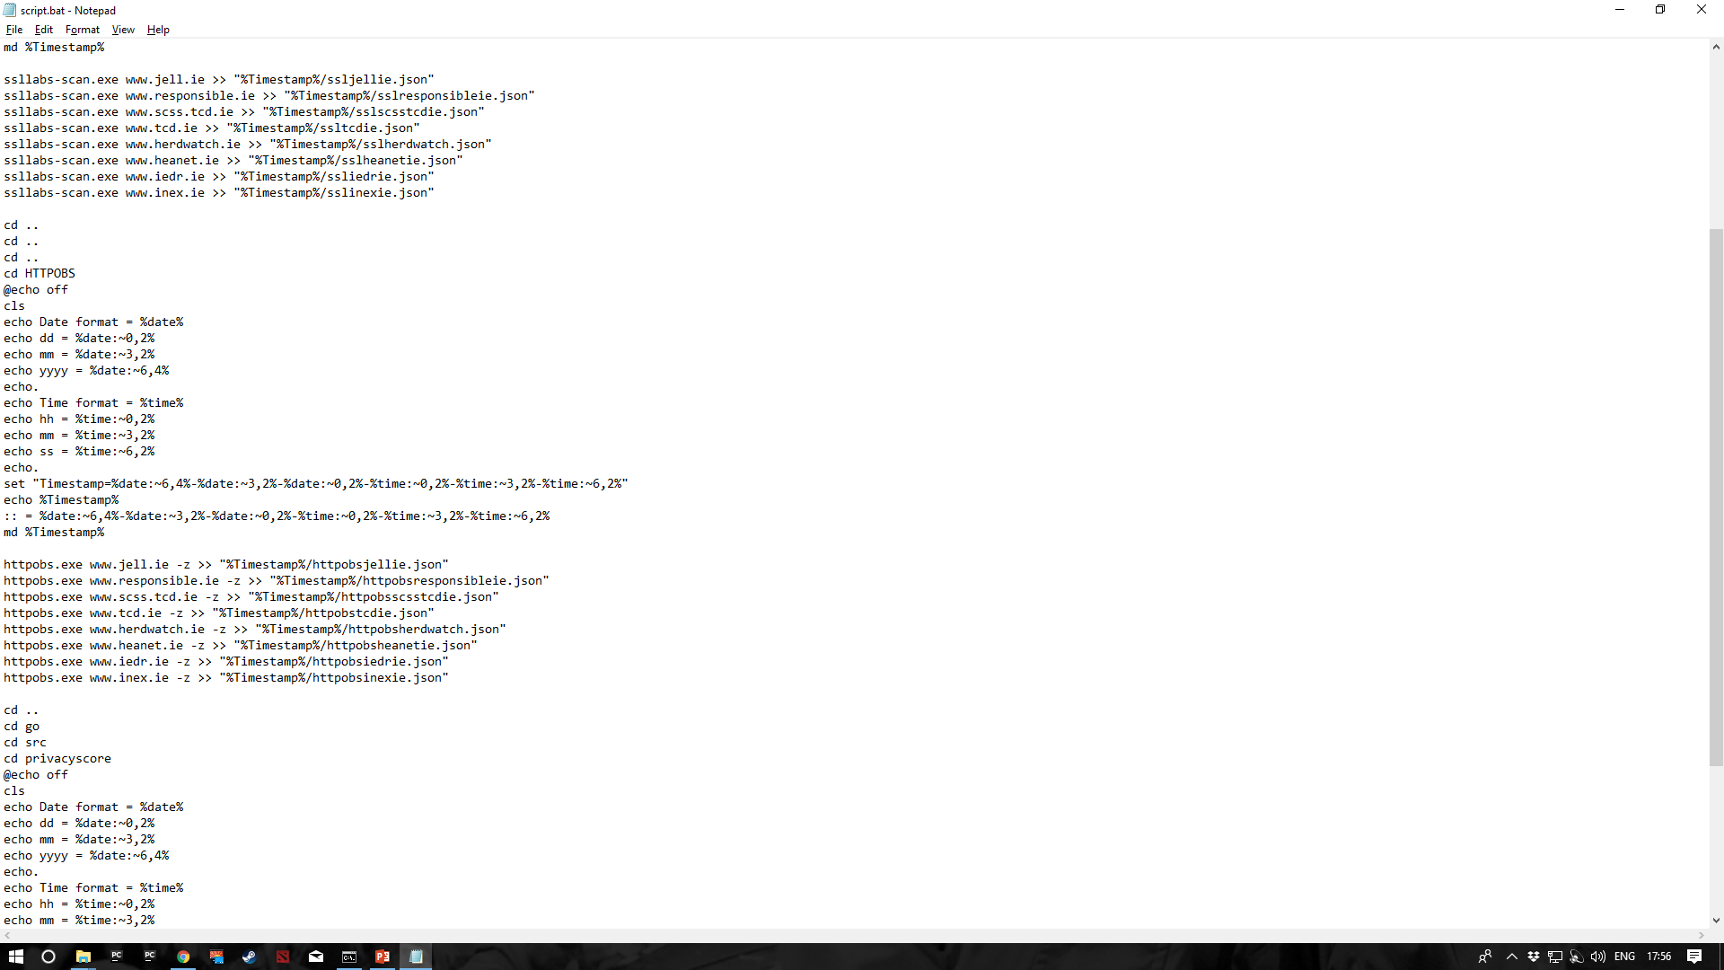
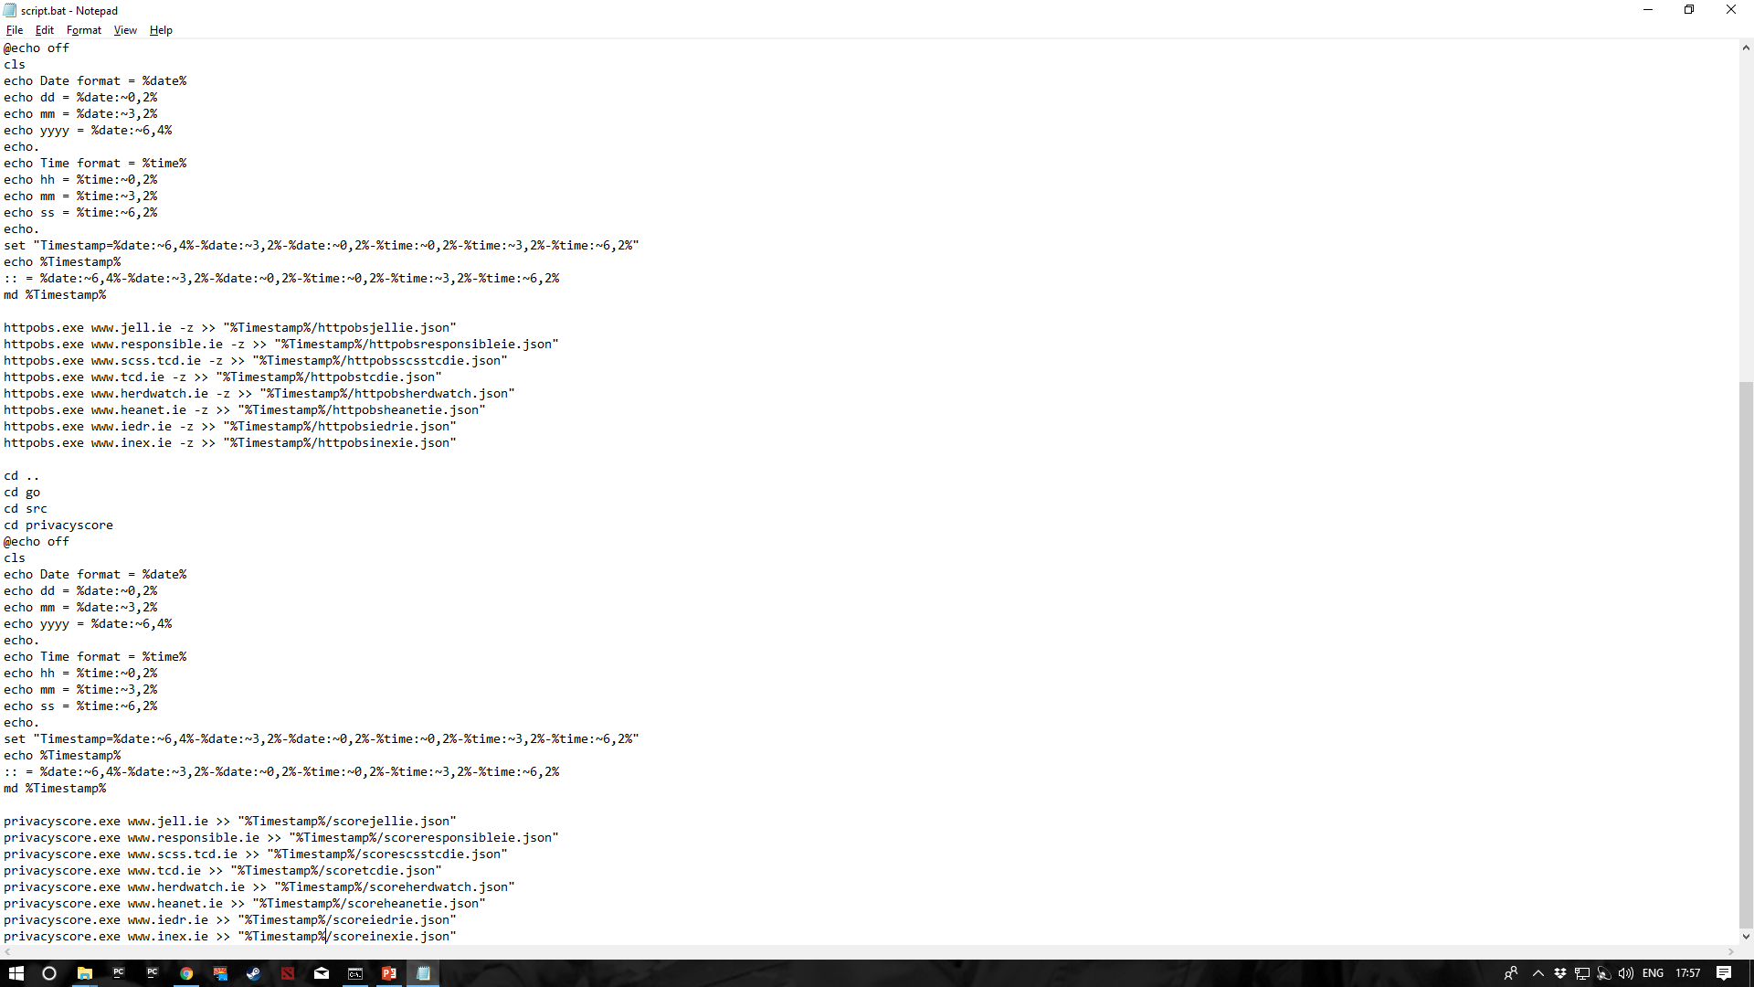
Methodology – Fetching the result
“Cd ..“ command bring the user one directory back, in my case I need to go back different amount of times.
The rest of the code is exactly the same, just using different testers.

Slide 14
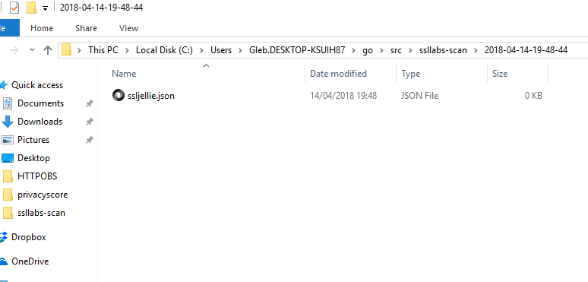
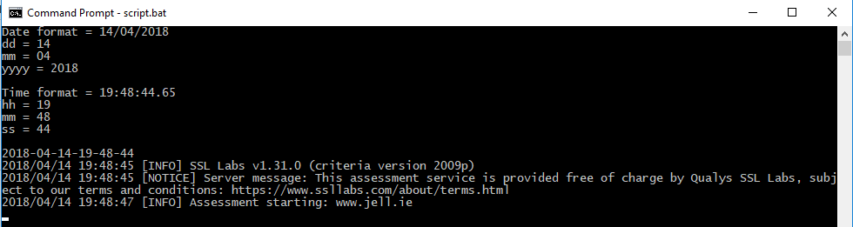
An example of what happens when the script runs:
New directory created with the name as a current timestamp
A list of all test sites created as JSON.

Slide 15
Results
As the result, there is 8 JSON files that were generated from each tester, meaning that there will be 8*4 comparisons, as there are 4 testers that output their results.
An easy way to test the testers in this case is just to look at the results and their output. Some testers provide 2000 lines of JSON data while others only give around 1 – 30 depending on the parameters passed.
Next obvious step is to compare the results using FC (file compare) cmd command of 2 testers. For some of them it may not work, because the output would be “Files are too different”. This step will work when the smaller files will be compared.

Slide 16
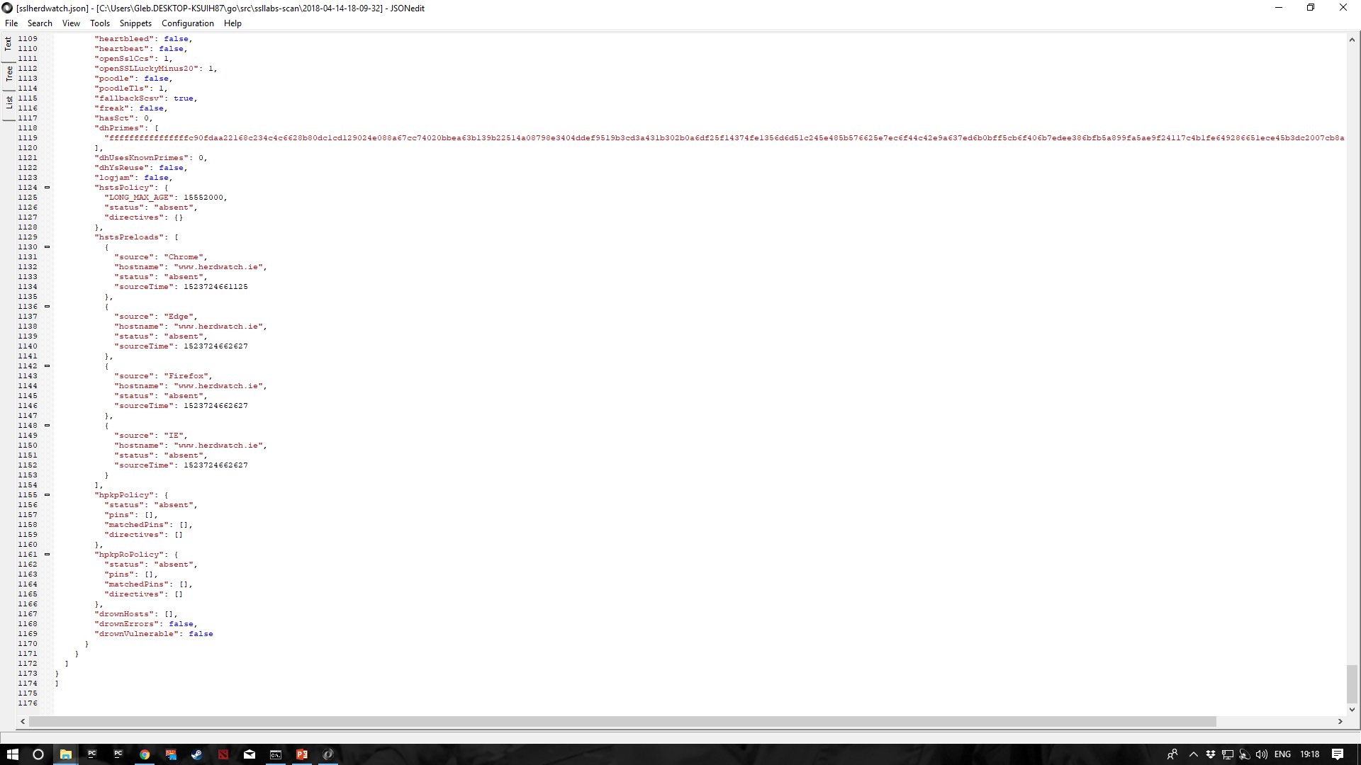
Results –SSLLABS Example

Slide 17
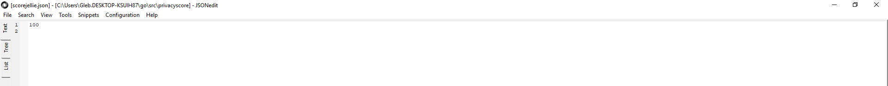
Results - Privacyscore
A Simple output of the end score ☺ Needs to be screen scraped

Slide 18
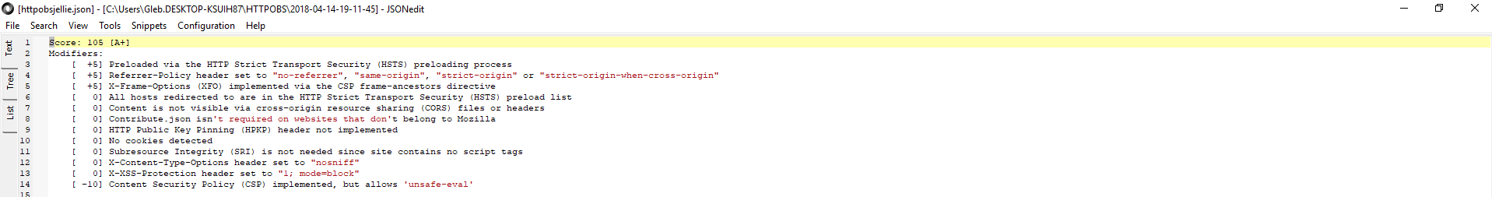
Results – HTTPS Observatory
Only 15 lines, and that also includes “0” scores, this can be seen in the script where I add “-z” to the test site name

Slide 19
Conclusion
Even though the final goal is not yet completed, all the material (results) are generated, so there needs to be a lot of comparing done between the testers, where the key differences in operation and result output should be identified.
If I was to do this project all over again, the only things I would do differently is get through the first three steps as quickly as possible, especially generating the results as it took me a while to mess around with the script. This would allow me to spend more time for the main and final goal, actually comparing the testers .

Slide 20

Questions ?!

